Slide 1
FACE RECOGNITION
HOW BIOMETRICS WILL BE UTILIZED TO COUNTER TERRORISM
Presented By:
Carlos Buskey
THE LAST MINUTE ADDTION

Slide 2
THIS PRESENTATION WILL COVER…
INTRODUCTION TO BIOMETRICS
HISTORY OF BIOMETRICS
TYPES OF BIOMETRIC TECHNOLOGY
INTRO TO FACE RECOGNITION
FACE RECOGNITION USAGE IN AIRPORTS TO COUNTER TERRORISM
FUTURE OF FACE RECOGNITION

Slide 3
INTRODUCTION TO BIOMETRICS

Slide 4
QUESTION
Biometrics stands for:
The measurement of nuclear weapons
Life-measurements
The study of whether house hold plants will someday become a tree
Measuring size of DNA strands

Slide 5
INTRODUCTION TO BIOMETRICS
Biometrics (“Bio-“ stands for life and“metric” is to measure)

Slide 6
INTRODUCTION TO BIOMETRICS
“Biometric is using a computer to recognized physical and behavior characteristics of a human. These trait are captured by a computer and used to make one-to-one authentication and one-to-many comparison based on unique features[Visonics, 2001]”

Slide 7
BRIEF HISTORY OF BIOMETRICS
AND I MEAN BRIEF!!!!

Slide 8
QUESTION
Biometrics was first used:
During the first DPS Session
In the first James Bond Movie
Prehistoric times
During the Nixon Administration

Slide 9
HISTORY OF BIOMETRICS
Biometrics was used during prehistoric times.
Chinese used fingerprinting in the 14th Century for identification.
In the 17th century fingerprinting was used to seal official documents.

Slide 10
TYPES OF BIOMETRICS

Slide 11
TYPES OF BIOMETRICS
Finger prints
Retina Scans
Iris Scans
Voice recognition
Face recognition.

Slide 12
TYPES OF BIOMETRICS
Other forms of emerging Biometrics:
thermal scans
DNA (actually actively used in forensics)
Signatures
hand geometry
ear structure
heart rhythm

Slide 13
INTRODUCTION TO FACE RECOGNITION

Slide 14
QUESTION
What is face recognition?:
Discovering whether Michael Jackson has made a new change
Remembering a person at your class reunion
The ability to identify which President is on the 10 dollar bill.
The capturing of a facial image

Slide 15
INTRO TO FACE RECOGNITION
Face recognition is the capturing of a facial image, which is then transformed into a unique face print
The image is transformed using a technique called “elastic graph matching”.
Algebraic algorithms are used to make a perfect match.
Images are sent to a back-end database for comparison and possible matches.

Slide 16
FACE RECOGNITION IN AIRPORTS
ANTI- TERROISM TECHNOLOGY

Slide 17
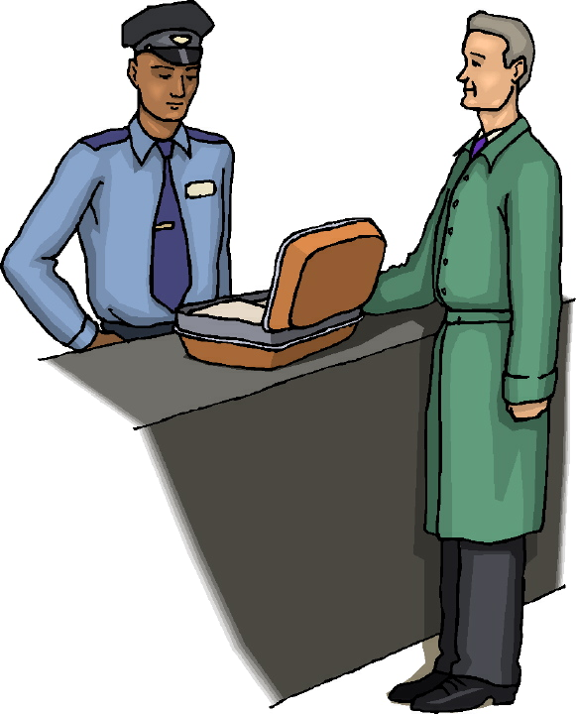
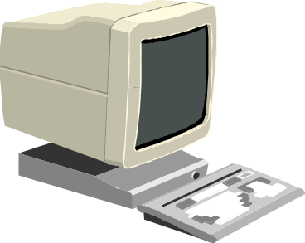
FACE RECOGNITION USAGE IN AIRPORTS TO COUNTER TERRORISM
Hi I am
Dr. Larry Bliss
Image is sent to
computer
for manipulation.

Slide 18


FACE RECOGNITION USAGE IN AIRPORTS TO COUNTER TERRORISM

Slide 19
FACE RECOGNITION USAGE IN AIRPORTS TO COUNTER TERRORISM

Slide 20
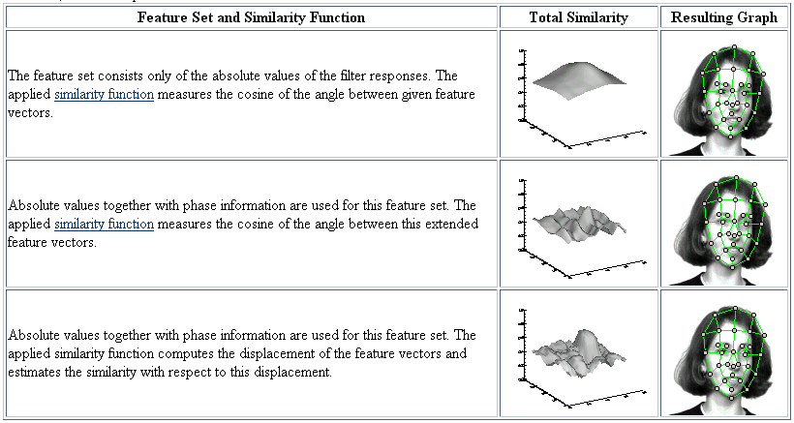
FACE RECOGNITION USAGE IN AIRPORTS TO COUNTER TERRORISM
Examples of jetting and Gabor wavelets
Ruhr-Universitat Bochum Research Ins. 2001

Slide 21
FACE RECOGNITION USAGE IN AIRPORTS TO COUNTER TERRORISM
Image is passed to database
for possible match

Slide 22
FACE RECOGNITION USAGE IN AIRPORTS TO COUNTER TERRORISM
WARNING!!!!
HOLD FOR
QUESTIONING

Slide 23
FUTURE OF FACE RECOGNITION
The Future is NOW!!

Slide 24
FUTURE OF FACE RECOGNITION
Neural Nets to improve accuracy and predictions.
Wearable computing will make face recognition ubiquitous .
Hybrids-face recognition/thermal scans
Hybrids-face recognition/voice recognition
Digitized images

Slide 25
FUTURE OF FACE RECOGNITION
May replace monetary exchange - credit cards and money
Utilized for security access to buildings and computers
Utilized to augment normal access to automobiles and homes
Face recognition will work with ATM’s to authenticate bank users by matching face prints with bank cards

Slide 26
THANK YOU
A NEGOTIATED OPTIONS PRODUCTION

